Slide 1


Group 1 Dinesh Anand Thulasiraman
Sailesh Baabu Suresh Babu
Sanjaram Raja Srinivasan
Notes:
Good afternoon, everyone. We are Group 1, and today we will be presenting our project FitForward: which is an Intelligent Interview Analysis and Feedback System.
This project is an extension of our previous work where we built a resume feedback system.
Introduce the team members

Slide 2

Table Of Contents
Introduction
Components
Problem Statement
Problem Elaboration
Project Scope
Video Analyzer
Audio Analyzer
Score Combiner
Literature Review
Conclusion
Methodology
Project Limitation
Future Research
Dataset Architecture
Dataset Description
Exploratory Data Analysis
Feature Engineering

Slide 3

Introduction – "Rethinking Interview Evaluation"
Traditional interviews rely heavily on gut feeling.
There's no consistent way to measure engagement, clarity, or confidence.
Virtual interviews add more complexity to candidate evaluation.

Slide 4

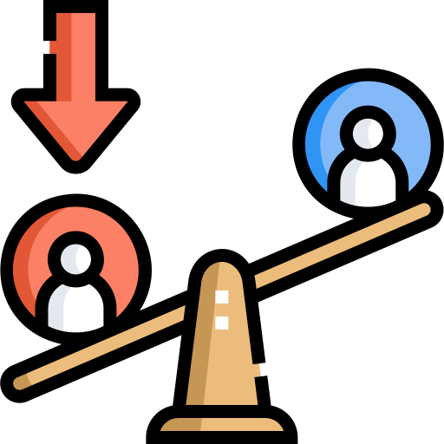

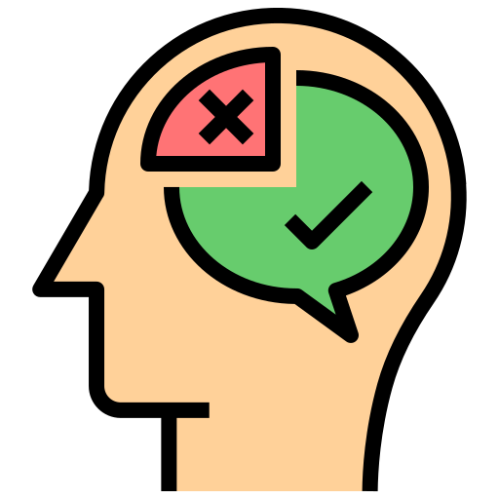
The Gaps in Traditional Interviewing
No standardized scoring system Decisions rely on gut instinct | Subjectivity and bias Influences candidate evaluation unfairly
Lack of structured feedback Candidates don’t know how to improve | Inconsistent evaluations Different interviewers apply different standards

Slide 5


Problem Elaboration
Recruiter Perspective | Candidate Perspective
📉 Hard to assess soft skills consistently | ❓ No clear understanding of rejection reasons
⏳ Time-consuming evaluation process | 🔁 Repeating same mistakes in future interviews
⚖️ Risk of biased or inconsistent decisions | 📉 No actionable feedback to improve performance

Slide 6
Problem Scope
🎯 Design a system to analyze interview behavior The project focuses on identifying key non-verbal and verbal signals from video and audio data to support fairer and more informative interview evaluations.
🧰 Use real-time facial and speech cues to generate behavioral insights This includes attention and engagement detection through video, speech quality and fluency tracking from audio, and a rule-based scoring mechanism that blends both.
📊 Personalized feedback report for candidates The system outputs a performance summary with strengths, improvement areas, and a practical 4-week action plan to help candidates enhance communication and presence.

Slide 7
Literature Survey
📌 P. Ghadekar et al. (2023)
AI-powered resume screening and web scraping reduce hiring biases and malpractices. Insight: Focuses on automation and fairness in screening but lacks behavioral analysis.
📌 C. Czejdo & S. Bhattacharya (2021)
Deep learning models improve interview readiness and help address educational inequities. Insight: Emphasizes preparation tools, not post-interview performance analysis.
📌 P. Senarathne et al. (2021)
AI-driven systems automate interviews, assessing voice-based and textual responses. Insight: Focuses on vocal/textual input; non-verbal cues like facial behavior not considered.
📌 K. Appadoo et al. (2020)
Machine learning and NLP enhance job-matching accuracy in recommendation systems. Insight: Strong on job-role matching; doesn't assess candidate behavior directly.
📌 S. I. Horat et al. (2019)
Virtual AI interviews assist in early-stage candidate filtering using NLP and competence analysis. Insight: Targets early-stage filtering using NLP but lacks comprehensive candidate feedback.

Slide 8
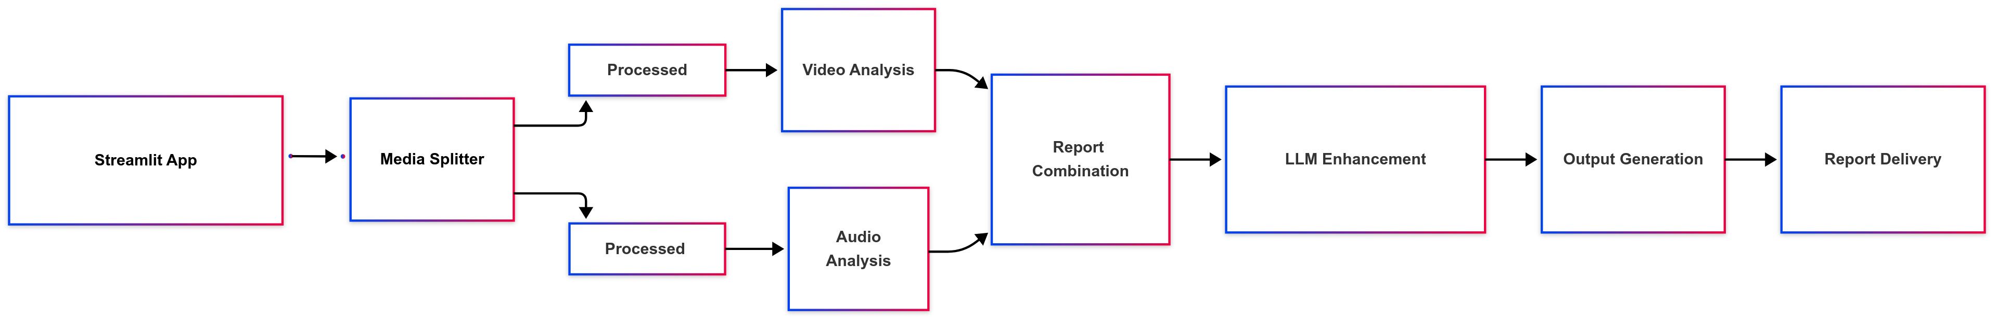
Architecture

Slide 9
DATASET DESCRIPTION
Dataset: MIT Interview Dataset
Purpose: Audio-visual recordings of mock job interviews for analysis.
Participants: 69 MIT students (each interviewed twice: pre & post-counselor intervention).
Total Interviews: 138
Annotations & Features: Collected using Amazon Mechanical Turk and various feature extraction methods.

Slide 10
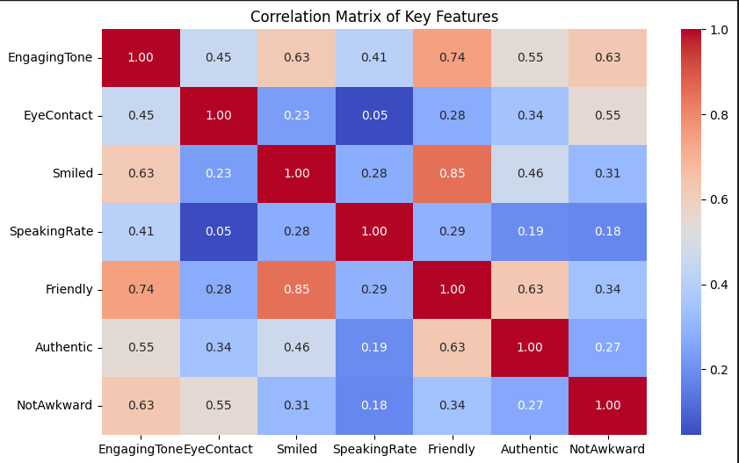
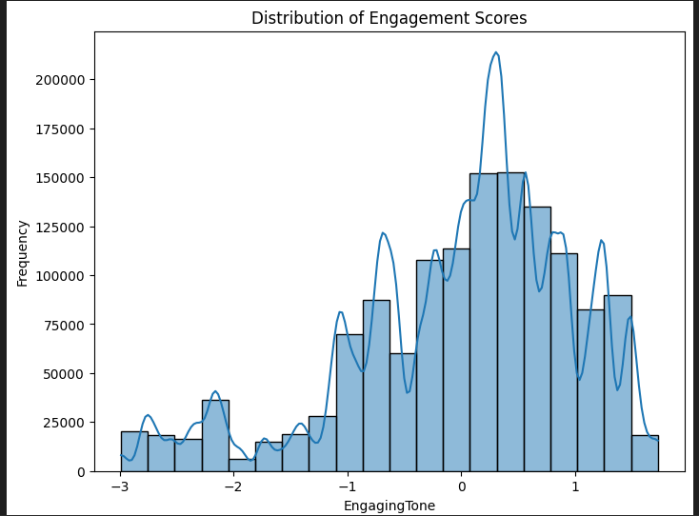
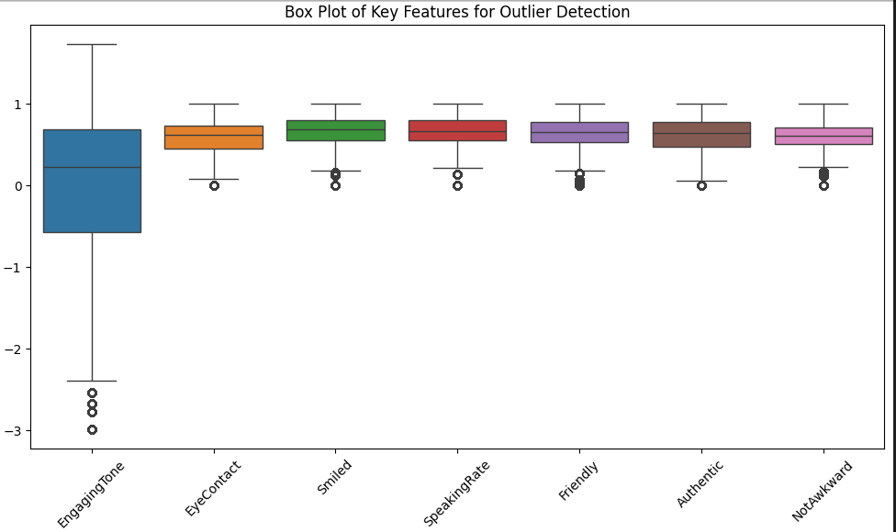
Exploratory Data Analysis
Correlation Matrix
Friendly & Smiled had the strongest correlation (0.85).
Engagement Score Histogram
Scores were normally distributed around 0.
Box Plot
EngagingTone showed the most outliers among features.

Slide 11
Extracted Feature Data – Video & Audio
📹 Video Data
🎙️ Audio Data
Format | MP4 / AVI
Duration | ~4 minutes/interview
Frame Rate | 60 FPS
Landmarks Extracted | 478 facial points (x, y, z)
Feature Vector Size | 1411 features per frame
Avg. Frames/Interview | ~14,706 frames
Format | WAV
Sample Rate | 22,050 Hz
Duration | ~4 minutes/interview
Extracted Features | MFCCs, Chroma, Mel, Spectral Contrast
Feature Vector Size | ~128 features per audio sample
Total Samples | 138 audio files

Slide 12
Video Analyzer
Key Metrics Calculated
Face Detection Rate (% of frames)
Attention Score (head pose + gaze)
Engagement Score (expression + movement)
Final Score = 30% Detection + 40% Attention + 30% Engagement
Model Architecture
Input: 1411 features (from 478 × 3 coords)
Hidden: 256 neurons, ReLU + Dropout(0.5)
Output: 1 neuron (Sigmoid → Binary: Engaged/Not Engaged)
Trained on MIT dataset (138 interviews)

Slide 13
Audio Analyzer
Scored Metrics
Voice Quality → MFCC stability + pitch consistency
Energy Level → Based on RMS energy
Speech Rate → Words per minute (~150 wpm optimal)
Clarity → Fluency & articulation (derived from spectral sharpness)
All scores normalized between 0.0 and 1.0
Model Architecture
Input: 128-dimensional feature vector
Hidden Layer: 128 → 64 neurons, ReLU, Dropout(0.5)
Output Layer: 1 neuron, Sigmoid → Voice Clarity Classification
Training Data: 138 labeled audio samples from MIT Dataset

Slide 14
Combined Score Logic
🎥 Video Score Formula
Video Score = 30% × Face Detection Rate + 40% × Avg. Attention Score + 30% × Avg. Engagement Score
🎙️ Audio Score Formula
Audio Score = 25% × Voice Quality + 35% × Energy Level + 20% × Speech Rate + 20% × Clarity
🧠 Final Score Logic
60% weight → better-performing modality (video or audio)
40% weight → weaker modality
+5 Bonus → if Attention or Engagement > 0.8
+5 Bonus → if Voice Quality or Energy > 0.8
+5 Bonus → if Audio & Video scores are within 10% (consistency)
Score is capped at 100, rounded to 2 decimals

Slide 15
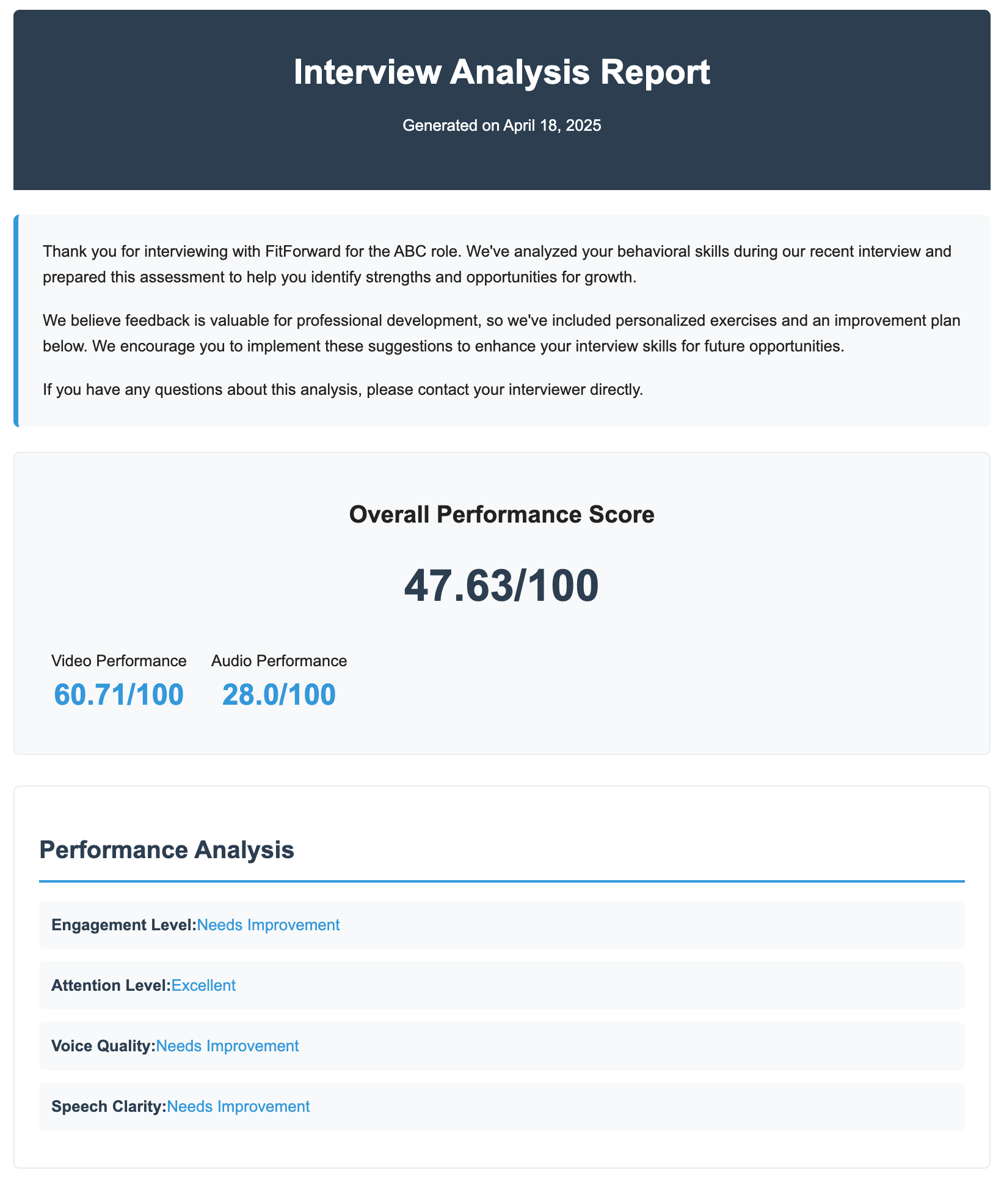
Final Report
Overall Score (out of 100)
Video & Audio Scores
Performance Level (e.g., Excellent, Good, Needs Improvement)
Strengths Summary (automatically extracted)
Areas for Improvement (based on low-scoring metrics)
4-Week Improvement Plan (Week-by-week suggestions)

Slide 16
Conclusion
🔹 🔍 Analysis
Built a system that analyzes interview behavior using video + audio inputs
Extracted attention, engagement, fluency metrics
🔹 🧪 Hybrid Model
Combined pretrained models (MediaPipe, face_recognition) with custom-trained neural networks
🔹 📊 Scoring
Calculated structured scores: face detection, voice clarity, speech rate, etc
🔹 📄 Feedback
Delivered reports with improvement areas and personalized exercises
🔹 📈 Growth
Designed to help candidates continuously improve via data-driven coaching

Slide 17
Project Limitation
🔹 Dataset
Limited to 138 videos (MIT) — lacks diversity in demographic/professional context
🔹 Labels
Engagement labels are subjective (crowdsourced via Amazon Mechanical Turk)
🔹 Audio Noise
Sensitive to poor microphone quality and background disturbances
🔹 Real-Time
Currently designed for post-interview evaluation only (not live feedback)
🔹 Bias
Facial scoring may not generalize well across all neurotypes or camera settings

Slide 18
Future Enhancements
Reinforcement Learning for Feedback Optimization:
Incorporate reinforcement learning to adapt feedback based on candidate improvement patterns over time.
Expansion to Technical Skill Evaluation:
Extend the system to evaluate technical responses (e.g., coding, problem-solving) alongside behavioral cues.
Real-Time Interview Analysis:
Enable real-time tracking and guidance during live interviews via browser-based or video call integration.

Slide 19
Thank You!!
Any Questions?

